Slide 1

David M. Kroenke and David J. Auer Database Processing: Fundamentals, Design, and Implementation
Chapter Three:
The Relational Model and Normalization

Slide 2
Chapter Objectives
To understand basic relational terminology
To understand the characteristics of relations
To understand alternative terminology used in describing the relational model
To be able to identify functional dependencies, determinants, and dependent attributes
To identify primary, candidate, and composite keys
To be able to identify possible insertion, deletion, and update anomalies in a relation

Slide 3
Chapter Objectives
To be able to place a relation into BCNF normal form
To understand the special importance of domain/key normal form
To be able to identify multivalued dependencies
To be able to place a relation in fourth normal form

Slide 4
Chapter Premise
We have received one or more tables of existing data.
The data is to be stored in a new database.
QUESTION: Should the data be stored as received, or should it be transformed for storage?

Slide 5
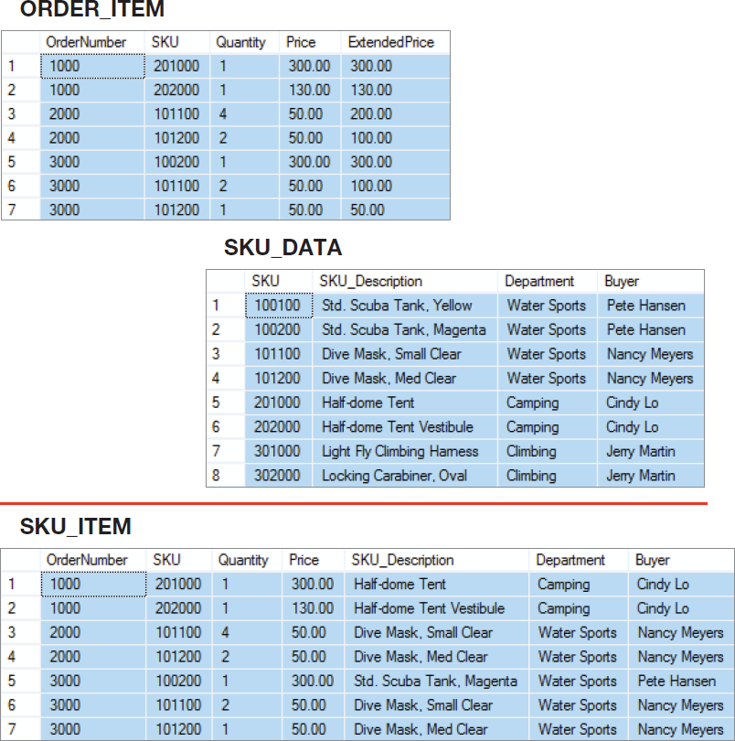
How Many Tables?
Should we store these two tables as they are, or should we combine them into one table in our new database?
Notes:
You can design the new database to store this data as two separate tables, or you can join the tables together and design the database with just one table.
Each alternative has advantages and disadvantages. When you make the decision to use one design, you obtain certain advantages at the expense of certain costs.
The purpose of this chapter is to help you understand those advantages and costs.

Slide 6
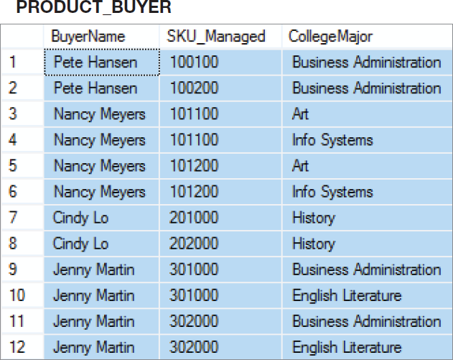
A Very Strange Table!
To understand why this is a very strange table, consider how you would add the fact that Nancy Meyers is now managing SKU 101300!
Notes:
To understand why this is an odd table, suppose that Nancy Meyers is assigned a new SKU, say 101300. What addition should we make to this table?
Clearly, we need to add a row for the new SKU, but if we add just one row, say the row ('Nancy Meyers', 101300, 'Art'), it will appear that she manages product 101300 as an Art major, but not as an Info Systems major.
To avoid such an illogical state, we need to add two rows:
('Nancy Meyers', 101300, 'Art') and ('Nancy Meyers', 101300, 'Info Systems').
Now, that is strange!

Slide 7
But First—
We need to understand:
The relational model
Relational model terminology

Slide 8
The Relational Model
Introduced in a paper published in 1970.
Created by E.F. Codd
He was an IBM engineer
The model used mathematics known as “relational algebra”
Now the standard model for commercial DBMS products.

Slide 9
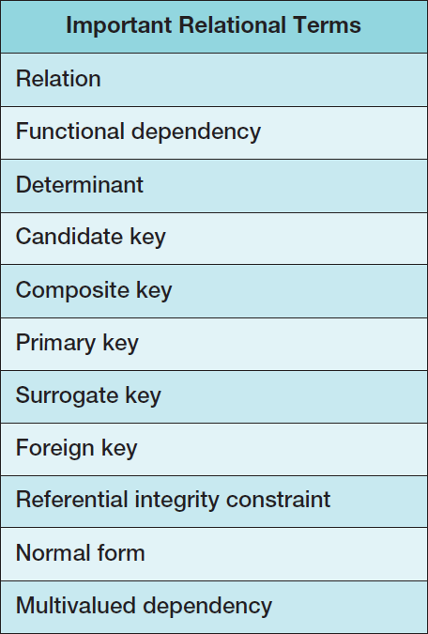
Important Relational Model Terms

Slide 10
Entity
An entity is some identifiable thing that users want to track:
Customers
Computers
Sales

Slide 11
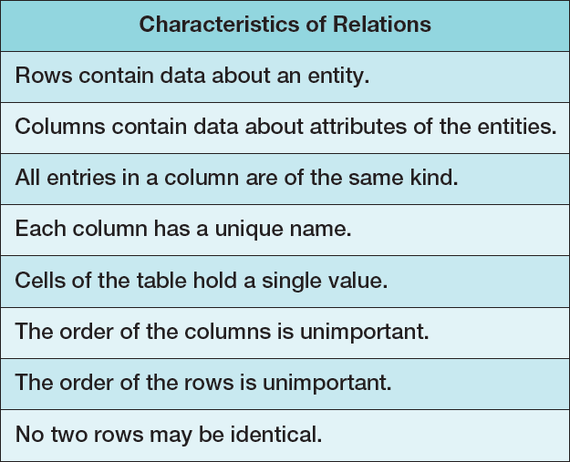
Relation
Relational DBMS products store data about entities in relations, which are a special type of table.
A relation is a two-dimensional table that has the following characteristics:

Slide 12
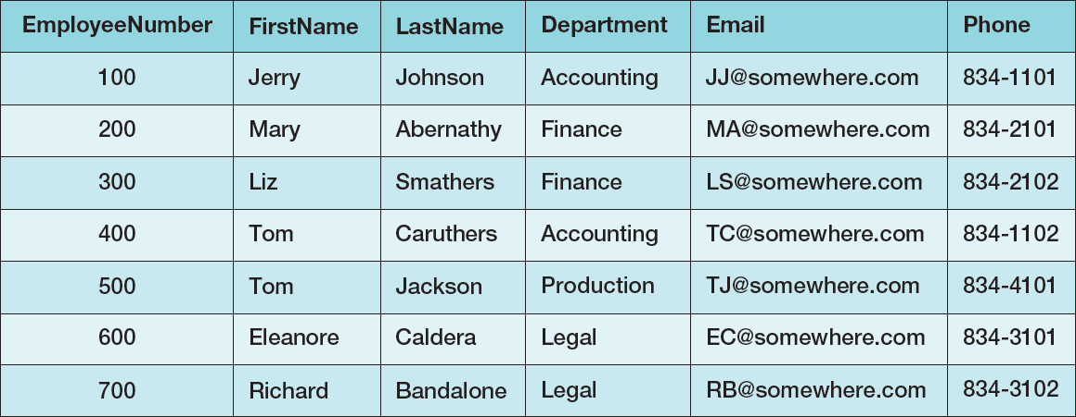
A Relation A Sample EMPLOYEE Relation

Slide 13
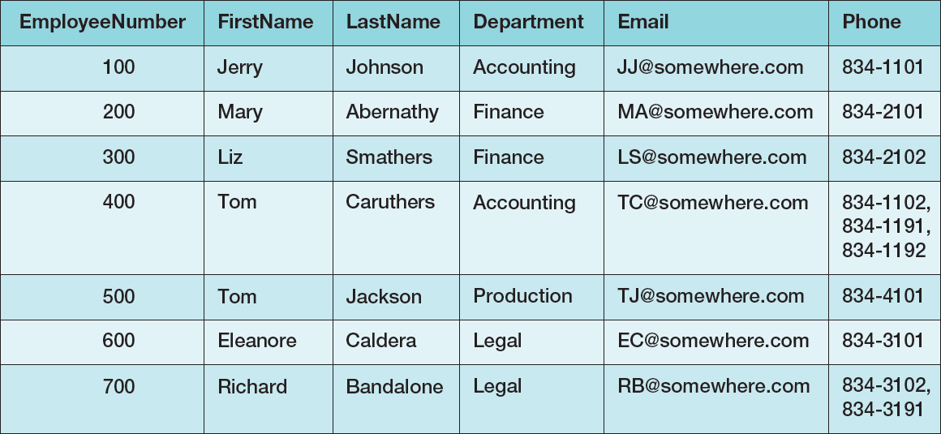
Tables That Are Not Relations: Multiple Entries per Cell

Slide 14
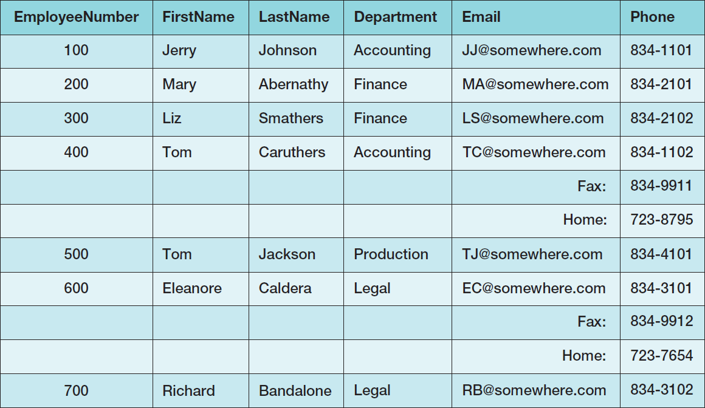
Tables That Are Not Relations: Table with Required Row Order

Slide 15
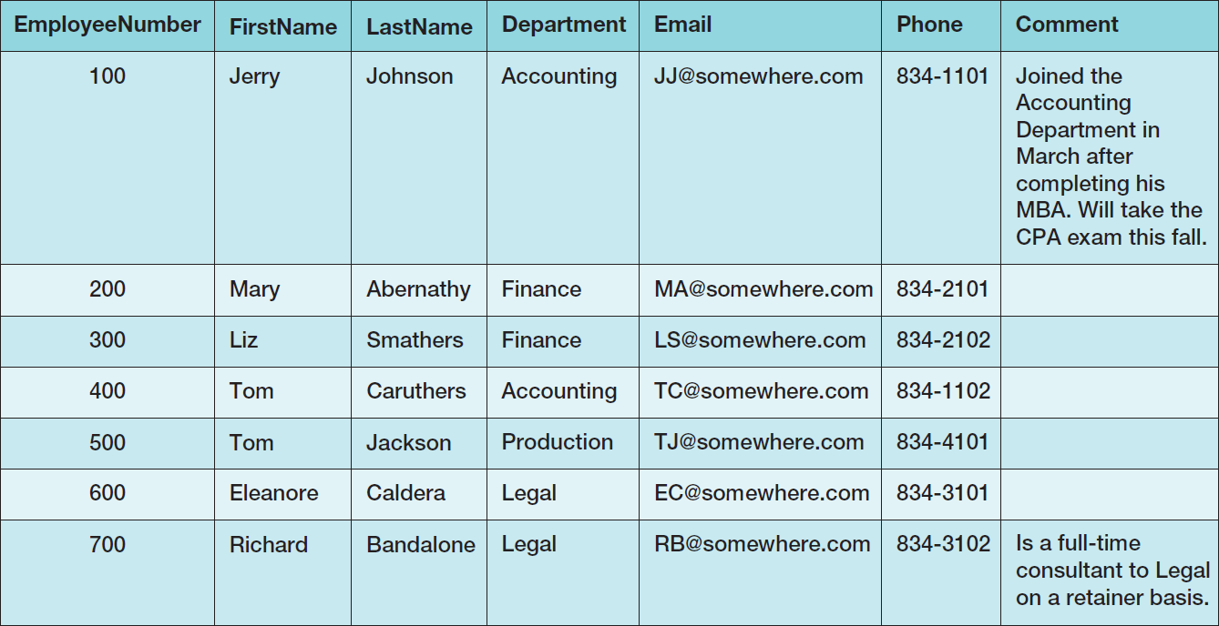
A Relation with Values of Varying Length

Slide 16
The Domain lntegrity Constraint
The requirement that all of the values in a column are of the same kind is know as the domain integrity constraint.
The term domain means a grouping of data that meets a specific type definition.
FirstName could have a domain of names such as Albert, Bruce, Cathy, David, Edith, and so forth.
All values of FirstName must come from the names in that domain.
Columns in different relations may have the same name.

Slide 17
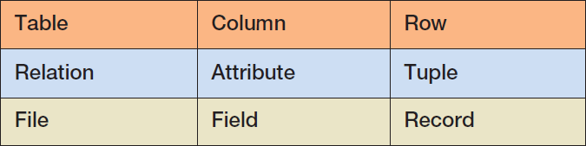
Alternative Terminology
Although not all tables are relations, the terms table and relation are normally used interchangeably.
The following sets of terms are equivalent:

Slide 18
To Key, or Not to Key That is the Question!
In a relation as defined by Codd:
The rows of a relation must be unique
These is no requirement for a designated primary key
The requirement for unique rows implies that a primary key can be designated.
In the “real world”, every relation has a primary key.
When do we designate a primary key?
We need some more information!

Slide 19
Functional Dependency
A functional dependency occurs when the value of one (set of) attribute(s) determines the value of a second (set of) attribute(s):
StudentID → StudentName
StudentID → (DormName, DormRoom, Fee)
The attribute on the left side of the functional dependency is called the determinant.
Functional dependencies may be based on equations:
ExtendedPrice = Quantity X UnitPrice
(Quantity, UnitPrice) → ExtendedPrice
Function dependencies are not equations!

Slide 20
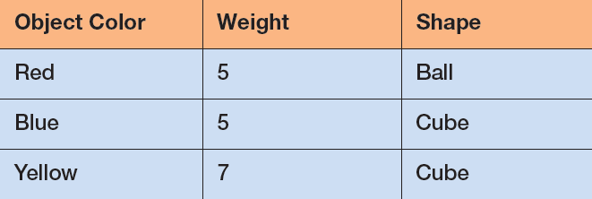
Functional Dependencies Are Not Equations
ObjectColor → Weight
ObjectColor → Shape
ObjectColor → (Weight, Shape)
Notes:
Perhaps the easiest way to understand functional dependencies is:
If I tell you one specific fact, can you respond with a unique
associated fact?
Using the table above, if I tell you that that the ObjectColor is Red, can you uniquely tell me the associated Shape?
Yes, you can and it is Ball. Therefore, ObjectColor deter- mines Shape, and a functional dependency exists with ObjectColor as the determinant.
Now, if I tell you that that the Shape is Cube, can you uniquely tell me the associated ObjectColor?
No, you cannot because it could be either Blue or Yellow. Therefore, Shape does not determine ObjectColor, and ObjectColor is not functionally dependent on Shape.

Slide 21
Composite Determinants
Composite determinant = a determinant of a functional dependency that consists of more than one attribute
(StudentName, ClassName) → (Grade)

Slide 22
Functional Dependency Rules
If A → (B, C), then A → B and A→ C.
This is the decomposition rule.
If A → B and A→ C, then A → (B, C).
This is the union rule.
However, if (A,B) → C, then neither A nor B determines C by itself.

Slide 23
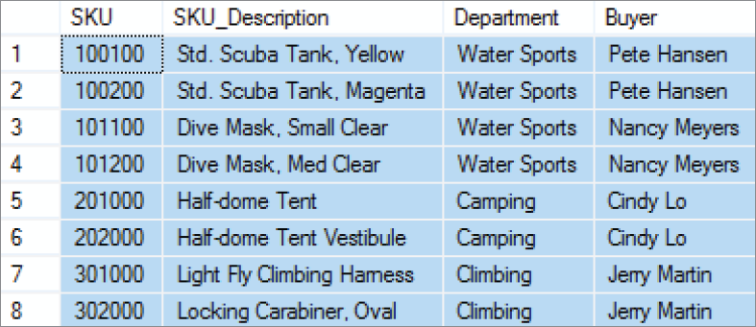
Functional Dependencies in the SKU_DATA Table

Slide 24
Functional Dependencies in the SKU_DATA Table
SKU → (SKU_Description, Department, Buyer)
SKU_Description → (SKU, Department, Buyer)
Buyer → Department
Notes:
As stated, for the Buyer determines Department functional dependency, a Buyer is paired with one and only one value of Department.
Notice that a buyer can appear more than once in the table, but, if so, that buyer is always paired with the same department.
This is true for all functional dependencies. If A determines B, then each value of A will be paired with one and only one value of B. A particular value of A may appear more than once in the relation, but, if so, it is always paired with the same value of B.
Note, too, that the reverse is not necessarily true. If A determines B, then a value of B may be paired with many values of A.

Slide 25
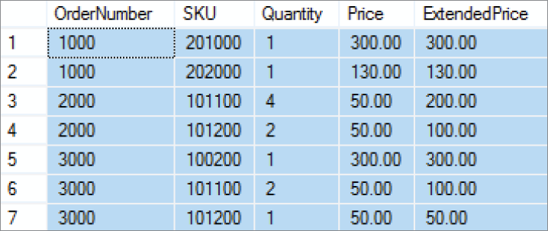
Functional Dependencies in the ORDER_ITEM Table

Slide 26
Functional Dependencies in the ORDER_ITEM Table
(OrderNumber, SKU) →
(Quantity, Price, ExtendedPrice)
(Quantity, Price) → (ExtendedPrice)
Notes:
You cannot always determine functional dependencies from sample data.
You may not have any sample data, or you may have just a few rows that are not representative of all of the data conditions. In such cases, you must ask the users who are experts in the application that creates the data.
For the SKU_DATA table, you would ask questions such as, “Is a Buyer always associated with the same Department?” and “Can a Department have more than one Buyer?”
In most cases, answers to such questions are more reliable than sample data. When in doubt, trust the users.

Slide 27
What Makes Determinant Values Unique?
A determinant is unique in a relation if and only if, it determines every other column in the relation.
You cannot find the determinants of all functional dependencies simply by looking for unique values in one column:
Data set limitations
Must be logically a determinant

Slide 28
Keys
A key is a combination of one or more columns that is used to identify rows in a relation.
A composite key is a key that consists of two or more columns.

Slide 29
Candidate and Primary Keys
A candidate key is a key that determines all of the other columns in a relation.
A primary key is a candidate key selected as the primary means of identifying rows in a relation.
There is only one primary key per relation.
The primary key may be a composite key.
The ideal primary key is short, numeric, and never changes.
Notes:
What do you do if a table has no candidate keys?
In that case, define the primary key as the collection of all of the columns in the table.
Because there are no duplicate rows in a stored relation, the combination of all of the columns of the table will always be unique.
Again, although tables generated by SQL manipulation may have duplicate rows, the tables that you design to be stored should never be constructed to have data duplication.
Thus, the combination of all columns is always a candidate key.

Slide 30
The Entity lntegrity Constraint
The requirement that, in order to function properly, the primary key must have unique data values for every row in the table is know as the entity integrity constraint.
The phrase unique data values implies that this column is NOT NULL, and does not allow a NULL value in any row.

Slide 31
Surrogate Keys
A surrogate key is an artificial column added to a relation to serve as a primary key.
DBMS supplied
Short, numeric, and never changes—an ideal primary key
Has artificial values that are meaningless to users
Normally hidden in forms and reports

Slide 32
Surrogate Keys
NOTE: The primary key of the relation is underlined below:
RENTAL_PROPERTY without surrogate key:
RENTAL_PROPERTY (Street, City, State/Province, Zip/PostalCode, Country, Rental_Rate)
RENTAL_PROPERTY with surrogate key:
RENTAL_PROPERTY (PropertyID, Street, City,
State/Province, Zip/PostalCode, Country, Rental_Rate)

Slide 33
Foreign Keys
A foreign key is the primary key of one relation that is placed in another relation to form a link between the relations.
A foreign key can be a single column or a composite key.
The term refers to the fact that key values are foreign to the relation in which they appear as foreign key values.

Slide 34
Foreign Keys
NOTE: The primary keys of the relations are underlined and any foreign keys are in italics in the relations below:
DEPARTMENT (DepartmentName, BudgetCode, ManagerName)
EMPLOYEE (EmployeeNumber, EmployeeLastName,
EmployeeFirstName, DepartmentName)

Slide 35
The Referential Integrity Constraint
A referential integrity constraint is a statement that limits the values of the foreign key to those already existing as primary key values in the corresponding relation:
SKU in ORDER_ITEM must exist in SKU in SKU_DATA

Slide 36
Foreign Key with a Referential Integrity Constraint
NOTE: The primary key of the relation is underlined and any foreign keys are in italics in the relations below:
SKU_DATA (SKU, SKU_Description, Department, Buyer)
ORDER_ITEM (OrderNumber, SKU, Quantity, Price, ExtendedPrice)
Where ORDER_ITEM.SKU must exist in SKU_DATA.SKU
Notes:
While we have defined a referential integrity constraint to require a corresponding primary key value in the linked table, the technical definition of the referential integrity constraint allows for one other option—that the foreign key cell in the table is empty and does not have a value.
If a cell in a table does not have a value, it is said to have a null value (we will discuss null values in Chapter 4).
It is difficult to imagine a foreign key having null values in a real database when the referential integrity constraint is actually in use, and we will stick with our basic definition of the referential integrity constraint in this book. At the same time, be aware that the complete, formal definition of the referential integrity constraint does allow for null values in foreign key columns.

Slide 37
Database Integrity
We have defined three constraints so far in our discussion:
The domain integrity constraint
The entity integrity constraint
The referential integrity constraint
The purpose of these three constraints, taken as a whole, is to create database integrity, which means that the data in our database will be useful, meaningful data.

Slide 38
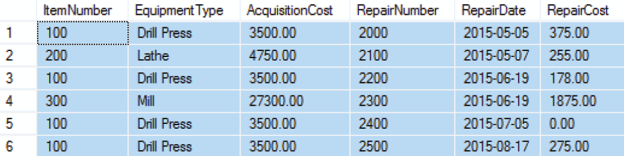
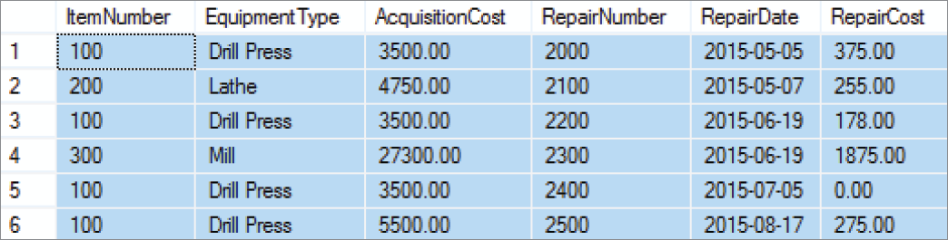
Modification Anomalies
The EQUIPMENT_REPAIR table before and after an incorrect update operation on AcquisitionCost for EquipmentType = Drill Press:

Slide 39
Types of Modification Anomalies
Deletion anomaly
Insertion anomaly
Update anomaly
Notice that the EQUIPMENT_REPAIR table duplicates data. For example, the AcquisitionCost of the same item of equipment appears several times. Any table that duplicates data is susceptible to update anomalies. A table that has such inconsistencies is said to have data integrity problems.

Slide 40
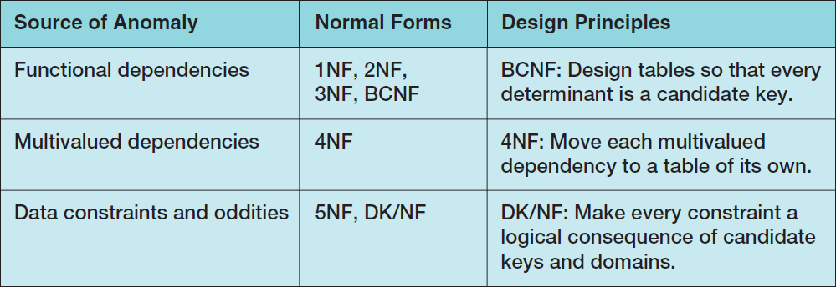
Normal Forms
Relations are categorized as a normal form based on which modification anomalies or other problems they are subject to:

Slide 41
To Key, or Not to Key Here is the Answer!
There are various opinions about whether or not a relation has to have a designated primary key to be in 1NF.
In this book, we will define 1NF as a table that:
Meet the set of conditions for a relation, and
Has a defined primary key

Slide 42
Normal Forms
1NF—a table that qualifies as a relation is in 1NF.
2NF—a relation is in 2NF if all of its nonkey attributes are dependent on all of the primary keys.
3NF—a relation is in 3NF if it is in 2NF and has no determinants except the primary key.
Boyce-Codd Normal Form (BCNF)—a relation is in BCNF if every determinant is a candidate key.
“I swear to construct my tables so that all nonkey columns are dependent on the key, the whole key and nothing but the key, so help me Codd.”

Slide 43
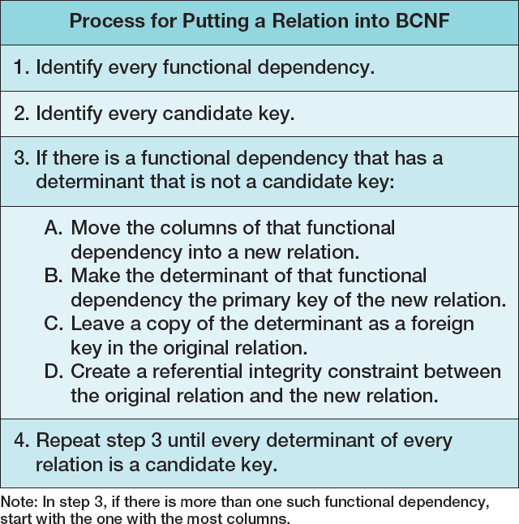
Eliminating Modification Anomalies from Functional Dependencies in Relations: Put All Relations into BCNF
Notes:
There is another, more intuitive way to think about normalization. Do you remember your eighth-grade English teacher? She said that every paragraph should have a single theme. If you write a paragraph that has two themes, you should break it up into two paragraphs, each with a single theme.
The problem with the EQUIPMENT_REPAIR relation is that it has two themes: one about repairs and a second about items. We eliminated modification anomalies by breaking that single table with two themes into two tables, each with a single theme.
Sometimes, it is helpful to look at a table and ask, “How many themes does it have?”
If it has more than one, then redefine the table so that it has a single theme.

Slide 44
Putting a Relation into BCNF: EQUIPMENT_REPAIR

Slide 45
Putting a Relation into BCNF: EQUIPMENT_REPAIR
EQUIPMENT_REPAIR (ItemNumber, Type, AcquisitionCost, RepairNumber, RepairDate, RepairAmount)
ItemNumber → (Type, AcquisitionCost)
RepairNumber → (ItemNumber, Type, AcquisitionCost, RepairDate, RepairAmount)
ITEM (ItemNumber, Type, AcquisitionCost)
REPAIR (RepairNumber, ItemNumber, RepairDate, RepairAmount)
Where REPAIR.ItemNumber must exist in ITEM.ItemNumber

Slide 46
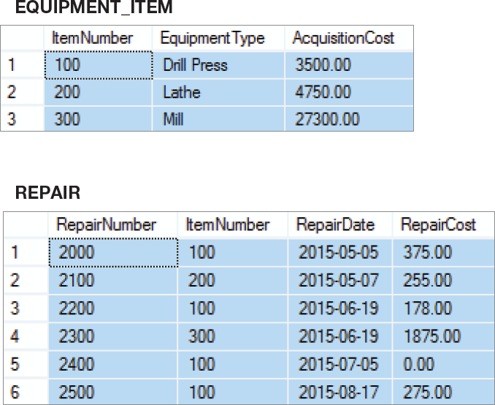
Putting a Relation into BCNF: New Relations

Slide 47
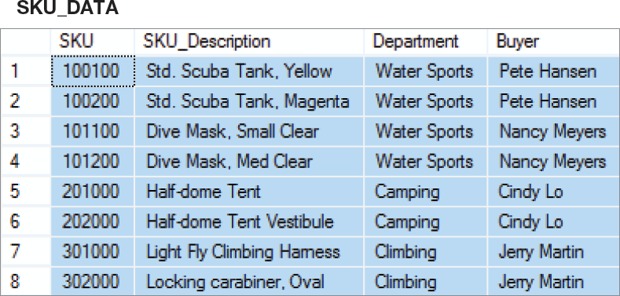
Putting a Relation into BCNF: SKU_DATA Step-by-Step – 1NF
SKU_DATA (SKU, SKU_Description, Department, Buyer)
1NF - Checking against the definition of 1NF, this relation is in 1NF.

Slide 48
Putting a Relation into BCNF: SKU_DATA Step-by-Step – 2NF
SKU_DATA (SKU, SKU_Description, Department, Buyer)
SKU → (SKU_Description, Department, Buyer)
SKU_Description → (SKU, Department, Buyer)
Buyer → Department
— SKU and SKU_Description are candidate keys.
— A relation is in 2NF if and only if it is in 1NF and all non-key attributes are determined by the primary key.
— Since SKU is a single column primary key, all non-key attributes are determined by SKU, and the relation is in 2NF.

Slide 49
Putting a Relation into BCNF: SKU_DATA Step-by-Step – 3NF
SKU_DATA (SKU, SKU_Description, Department, Buyer)
SKU → (SKU_Description, Department, Buyer)
SKU_Description → (SKU, Department, Buyer)
Buyer → Department
— SKU and SKU_Description are candidate keys.
— A relation is in 3NF if and only if it is in 2NF and there are no non-key attributes determined by another non-key attribute.
— However, the term non-key attribute means an attribute that is neither (1) a candidate key itself, nor (2) part of a composite candidate key.
— Therefore, the only non key attribute is Buyer, and it is a determinant. — Therefore, not in 3NF.

Slide 50
Putting a Relation into BCNF: SKU_DATA Step-by-Step – 3NF
— Therefore, break out the Buyer → Department functional dependency.
SKU_DATA_2 (SKU, SKU_Description, Buyer)
BUYER (Buyer, Department)
Where SKU_DATA_2.Buyer must exist in BUYER.Buyer
— SKU_DATA_2 is in 3NF
— BUYER is in 3NF

Slide 51
Putting a Relation into BCNF: SKU_DATA Step-by-Step – BCNF
SKU_DATA_2 (SKU, SKU_Description, Buyer)
BUYER (Buyer, Department)
Where SKU_DATA_2.Buyer must exist in BUYER.Buyer
SKU → (SKU_Description, Department, Buyer)
SKU_Description → (SKU, Department, Buyer)
Buyer → Department
— A relation is in BCNF if and only if it is in 3NF and every determinant is a candidate-key.
— In SKU_DATA_2, both determinants are determinant keys, so SKU_DATA_2 is in BCNF.
— In BUYER, the determinant is a determinant key, so BUYER is in BCNF.

Slide 52
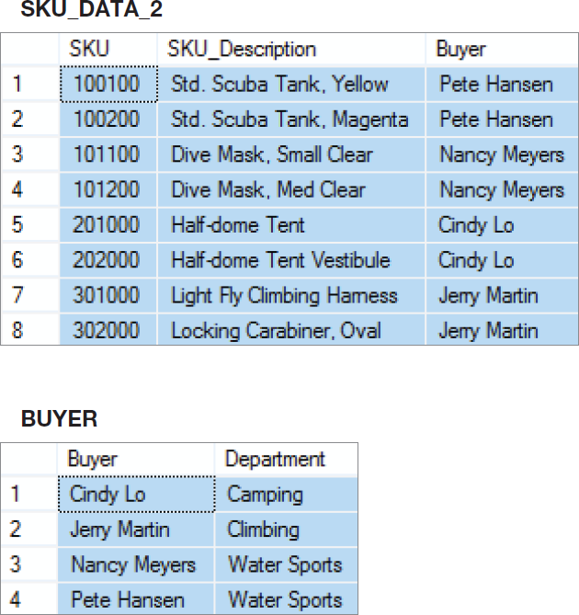
Putting a Relation into BCNF: SKU_DATA Step-by-Step – New Relations

Slide 53
Putting a Relation into BCNF: SKU_DATA Straight-to-BCNF

Slide 54
Putting a Relation into BCNF: SKU_DATA Straight-to-BCNF
SKU_DATA (SKU, SKU_Description, Department, Buyer)
SKU → (SKU_Description, Department, Buyer)
SKU_Description → (SKU, Department, Buyer)
Buyer → Department
— Therefore, break out the Buyer → Department functional dependency.
SKU_DATA (SKU, SKU_Description, Buyer)
BUYER (Buyer, Department)
Where BUYER.Buyer must exist in SKU_DATA.Buyer

Slide 55
Putting a Relation into BCNF: SKU_DATA Straight-to-BCNF New Relations

Slide 56
Multivalued Dependencies
A multivalued dependency occurs when a determinant is matched with a particular set of values:
Employee →→ Degree
Employee →→ Sibling
PartKit →→ Part
The determinant of a multivalued dependency can never be a primary key.

Slide 57
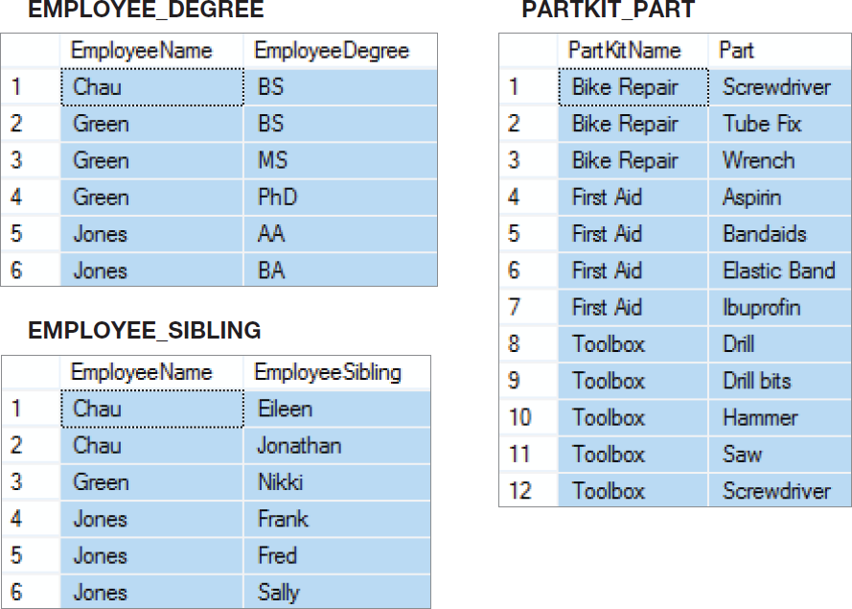
Multivalued Dependencies

Slide 58
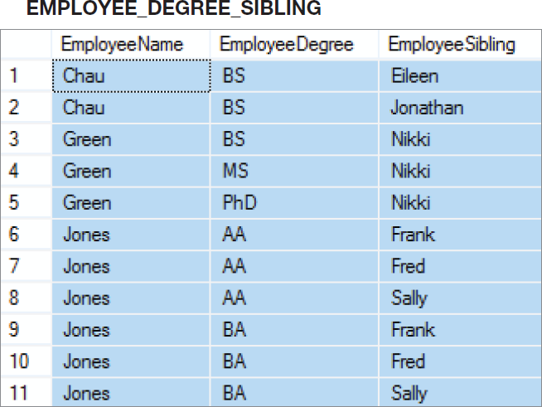
Two Multivalued Dependencies

Slide 59
Eliminating Anomalies from Multivalued Dependencies
Multivalued dependencies are not a problem if they are in a separate relation, so:
Always put multivalued dependencies into their own relation.
This is known as Fourth Normal Form (4NF).

Slide 60
That Very Strange Table Again!
Now we understand why this is a very strange table.
It has multivalued dependencies!
Notes:
To understand why this is an odd table, suppose that Nancy Meyers is assigned a new SKU, say 101300. What addition should we make to this table?
Clearly, we need to add a row for the new SKU, but if we add just one row, say the row ('Nancy Meyers', 101300, 'Art'), it will appear that she manages product 101300 as an Art major, but not as an Info Systems major.
To avoid such an illogical state, we need to add two rows:
('Nancy Meyers', 101300, 'Art') and ('Nancy Meyers', 101300, 'Info Systems').
Now, that is strange!

Slide 61
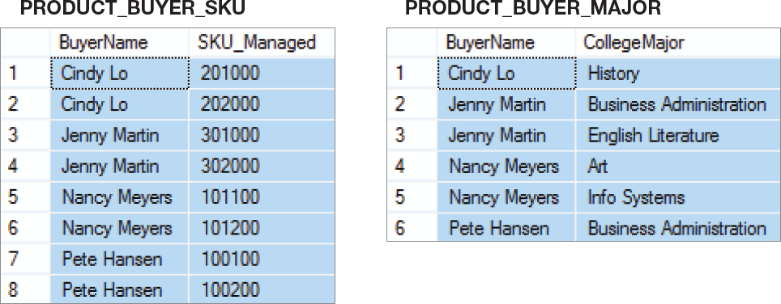
4NF
Use 4NF to resolve the multivalued dependencies!

Slide 62
David Kroenke and David Auer Database Processing Fundamentals, Design, and Implementation (14th Edition)
End of Presentation:
Chapter Three

Slide 63

All rights reserved. No part of this publication may be reproduced, stored in a retrieval system, or transmitted, in any form or by any means, electronic, mechanical, photocopying, recording, or otherwise, without the prior written permission of the publisher. Printed in the United States of America.

